Slide 1

GEN AI - Technology Hackathon
Gen-AI data profiling
TEAM NAME: NEWGEN
Team Name
NewGen

Slide 2

GEN AI - Technology Hackathon
Introduction
Develop a Gen-AI-powered solution for data profiling to ensure compliance with regulatory requirements.
Leverage LLMs and ML models to interpret reporting instructions and extract key data validation rules.
Automatically generate profiling rules and validation code to assess data consistency and accuracy.
Use unsupervised ML for anomaly detection and flagging suspicious transactions.
Build a scalable, explainable, and interactive compliance assistant that evolves with regulatory trends.
Team Name
NewGen

Slide 3
GEN AI - Technology Hackathon
Problem Statement
Regulatory reporting requires strict adherence to data validation rules, but manually interpreting and applying these rules is time-consuming and error-prone.
The goal is to build a Gen-AI-powered data profiling solution that can:
Extract and interpret regulatory instructions using Gen-AI.
Generate profiling rules and executable validation code.
Detect anomalies using unsupervised ML techniques.
Suggest remediation actions with automated explanations.
Team Name
NewGen

Slide 4
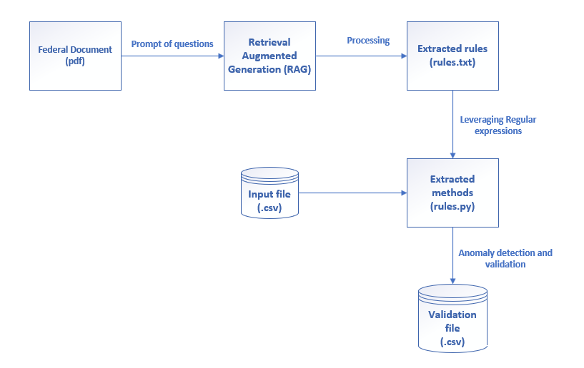

Architecture Diagram

Slide 5
GEN AI - Technology Hackathon
Tech Used
Automates Rule Generation: Extracts and refines regulatory reporting instructions using LLMs ( Mistral-7B-Instruct-v0.3) and RAG (Retrieval-Augmented Generation)
Validates Data Consistency: Detects anomalies using unsupervised ML techniques like clustering and anomaly detection.
Generates Validation Code: Auto-creates Python scripts to validate reported data against extracted rules leveraging the regular expressions and LLM.
Suggests Remediation Actions: Provides AI-driven remediation suggestions with explanations for auditors.
Adaptive Compliance Assistant: Evolves based on historical regulatory violations and transaction trends.
Team Name
NewGen

Slide 6


Artificial Intelligence
Home
About
Contact
Thank You

